Slide 1

Relative macro placement for faster physical design process METRIC 2022 Mohit Sharma Dr. Mohammed A. S. Khalid Date: October 29th, 2022 University of Windsor Department of Electrical and Computer Engineering

Slide 2
Outline
Background and Motivation
Main Contributions
Methodology
Experimental Results
Conclusion and Future Work

Slide 3
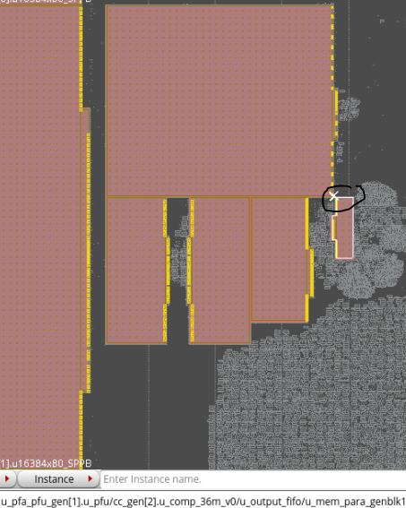
Background and Motivation
What are macro-cells? [1]
Modules or entities that represent certain design logic. Large blocks that can be viewed as black boxes.
Internal structural description may or may not be given although logic & electronic behavior is given. So, they have flexible geometries.
Much larger in size as compared to a standard cell.
What are standard-cells?
Group of transistor and interconnect structures that provides a Boolean logic function or a storage function.
Standard cells in the circuit have the same height.
Figure 1: Macro Cells (Marron Rectangular blocks) and Standard Cells (Grey Clouds)

Slide 4
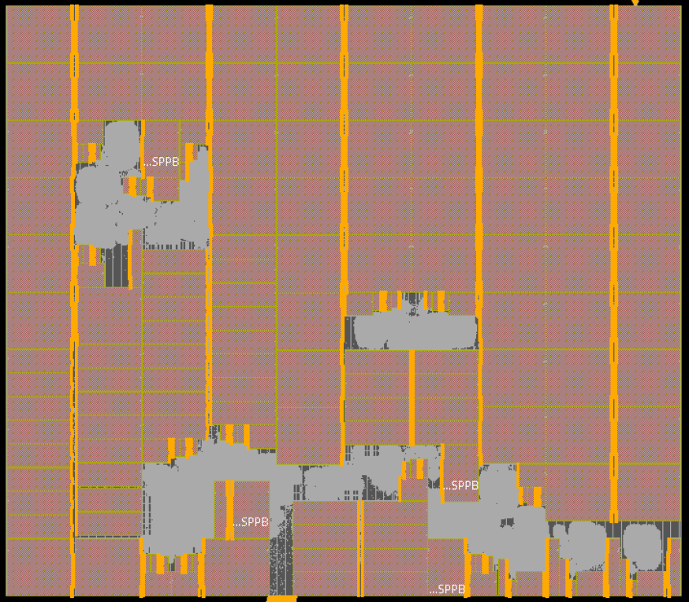
Background and Motivation
What is macro-cell placement?
Problem of placing a given macro cell circuit to optimize a certain design objective e.g., wirelength.
A macro cell circuit contains a small number of macro cells and a larger number of standard cells.
Standard Cells need to be placed in specified rows.
No overlap is allowed between any two cells being placed.
Figure 2: A placed macro-cell circuit

Slide 5
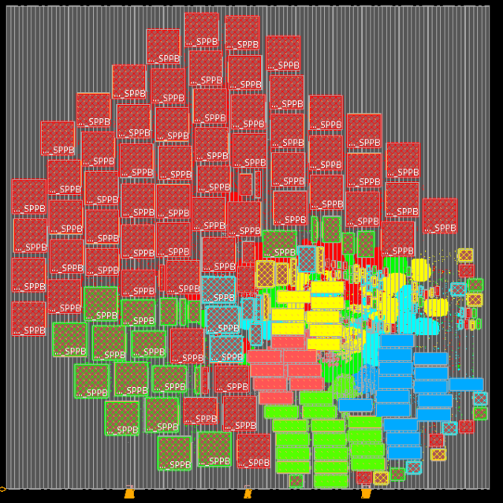
Background and Motivation
Commercially available physical design CAD tool for automated macro placement give unoptimized placement [2]
Placement done by automated macro placement tools have large Area, Wirelength and Power.
Figure on the right show's placement achieved by a commercially available physical design CAD tool.
Communicating memories spread out leading to larger wirelength.
Underutilized core with lots of empty space resulting in larger area.
Figure 3: Placement achieved by a commercially available physical design CAD tool.

Slide 6
Background and Motivation
Circuit | Flow | Wirelength |  | Congestion | Timing
 |  | WL | Norm. | GRC% | WNS% | TNS
c1 520k cells 32 macros | IndEDA | 13.19 | 1.029 | 6.51 | 0.0 | 0
 | HiDaP | 13.40 | 1.046 | 7.83 | 0.3 | 0
 | handFP | 12.81 | 1.000 | 7.36 | -0.2 | 0
c2 3.95M cells 100 macros | IndEDA | 46.01 | 1.180 | 12.99 | -44.5 | -931
 | HiDaP | 40.72 | 1.045 | 13.00 | -19.0 | -329
 | handFP | 38.97 | 1.000 | 9.33 | -11.2 | -213
c3 3.78M cells 94 macros | IndEDA | 44.83 | 1.175 | 10.09 | -75.5 | -553
 | HiDaP | 35.02 | 0.918 | 8.29 | -17.5 | -260
 | handFP | 38.16 | 1.000 | 9.15 | -17.8 | -317
c4 4.81M cells 122 macros | IndEDA | 45.03 | 1.174 | 7.24 | -54.4 | -2167
 | HiDaP | 40.43 | 1.054 | 4.94 | -31.2 | -2686
 | handFP | 38.35 | 1.000 | 3.33 | -22.8 | -1736
c5 1.39M cells 133 macros | IndEDA | 44.25 | 1.162 | 2.02 | -30.8 | -1940
 | HiDaP | 39.51 | 1.038 | 4.72 | -25.1 | -1149
 | handFP | 38.06 | 1.000 | 3.42 | -39.8 | -1017
c6 2.87M cells 90 macros | IndEDA | 96.42 | 1.288 | 9.95 | -70.0 | -15341
 | HiDaP | 79.20 | 1.058 | 2.22 | -37.0 | -5051
 | handFP | 74.87 | 1.000 | 1.63 | -27.3 | -3688
c7 1.67M cells 108 macros | IndEDA | 41.44 | 1.174 | 38.56 | -34.9 | -1060
 | HiDaP | 35.52 | 1.007 | 6.47 | -29.9 | -1059
 | handFP | 35.29 | 1.000 | 4.61 | -20.4 | -774
C8 2.20M cells 37 macros | IndEDA | 24.85 | 0.987 | 1.02 | -3.4 | -44
 | HiDaP | 23.75 | 0.944 | 1.37 | 0.0 | 0
 | handFP | 25.17 | 1.000 | 0.93 | -3.9 | -24
Current research affirms that automatic macro placement doesn’t achieve the most optimized metrics.
Table shows results from a research on an automated macro-placement tool called Hierarchical Dataflow Placement (HiDaP) and compares the placement metrics achieved for eight circuits with Industrial EDA tool (IndEDA) and hand-crafted Floorplan (handFP)
Hand-crafted Floorplan gave the best placement metrics, among the three methods utilized, for the greatest number of circuits out of the eight placed.
Table I: Table referenced from paper on RTL Aware Dataflow Driven macro placement [3].

Slide 7

Background and Motivation
Hand placement gives best results most of the times, but it is slow process.
200 macros – 2 weeks
What if this can be improved?
Develop methods and techniques that reduce hand crafted placement time.

Slide 8

Main Contribution
Relative Macro Placement
Simple Idea of relative placement.
Builds upon placement of already placed macros.
Analogous to building a puzzle.

Slide 9
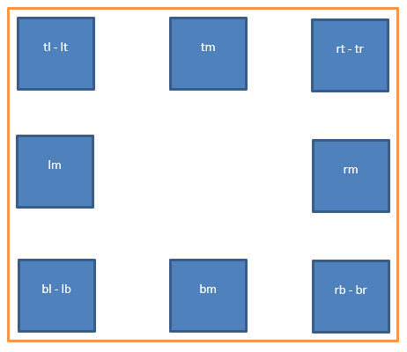
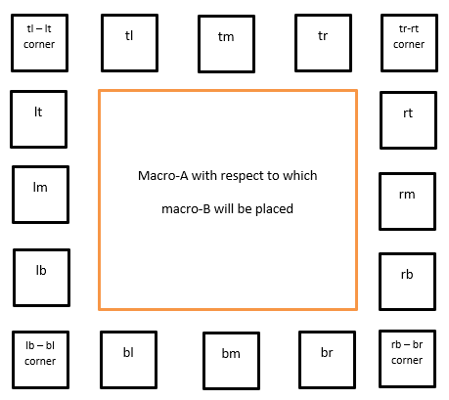
Methodology
Relative Macro Placement
Macro placement can be
With respect to core
With respect to another macro
Relative placement applicable in both the scenarios

Slide 10
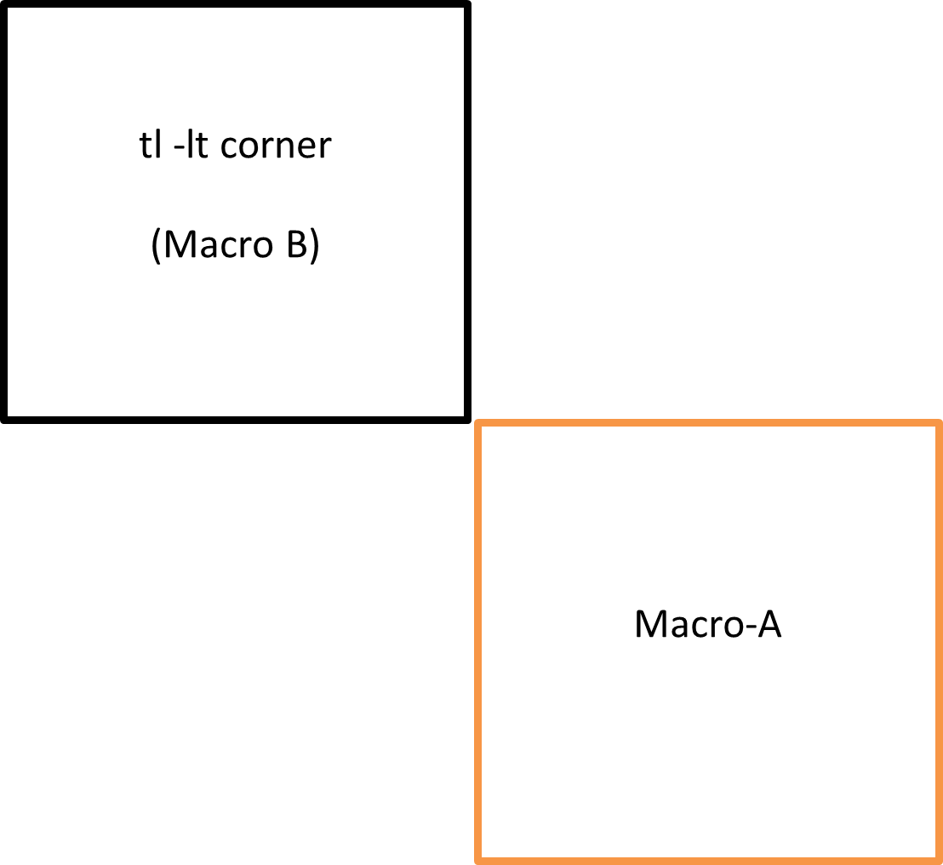
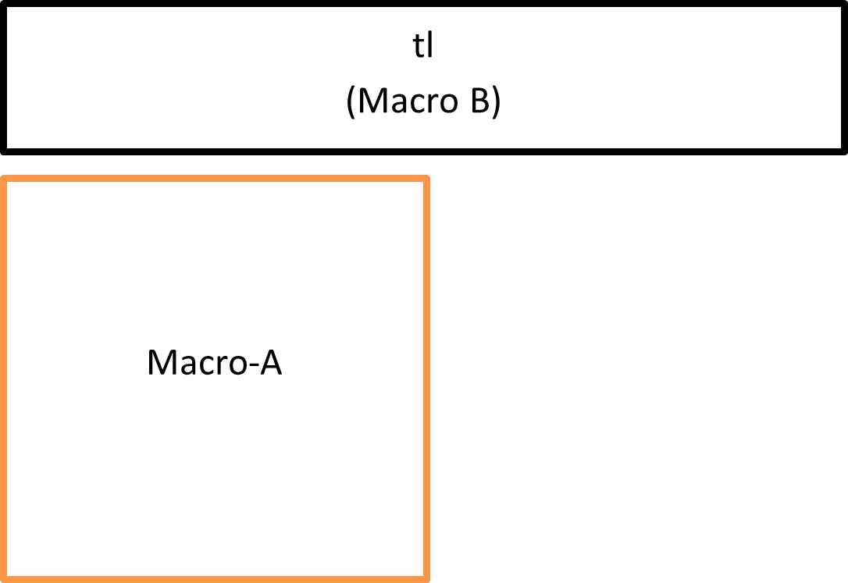
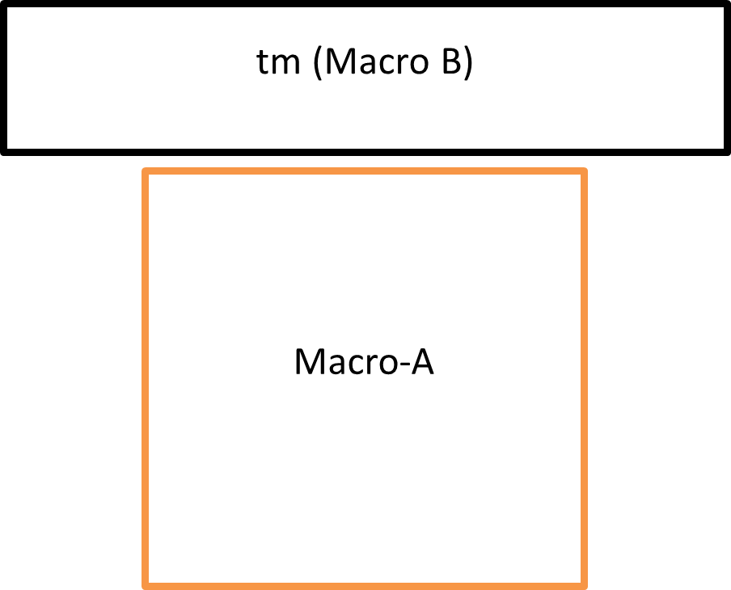
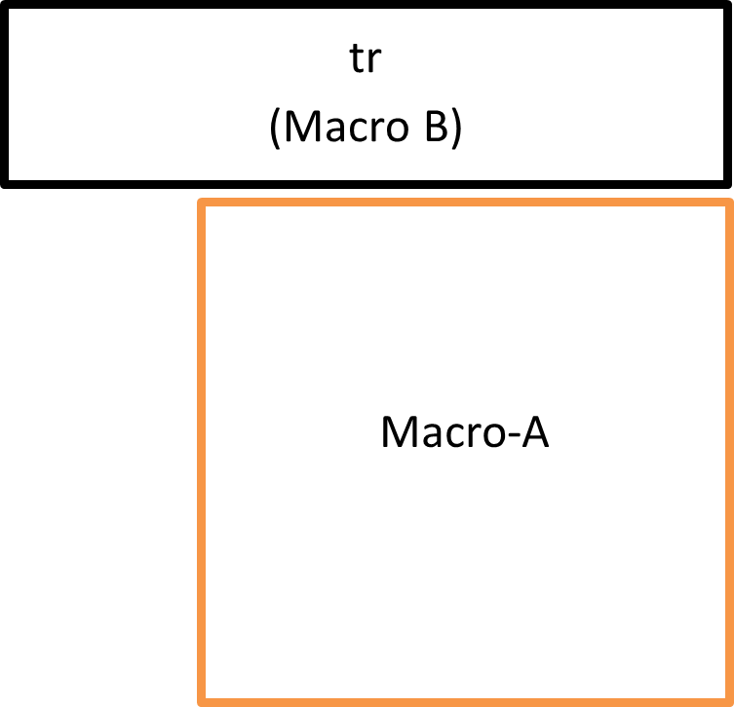
Top-left
Top-middle
Top-right
Top-left or Left-Top corner
Methodology

Slide 11
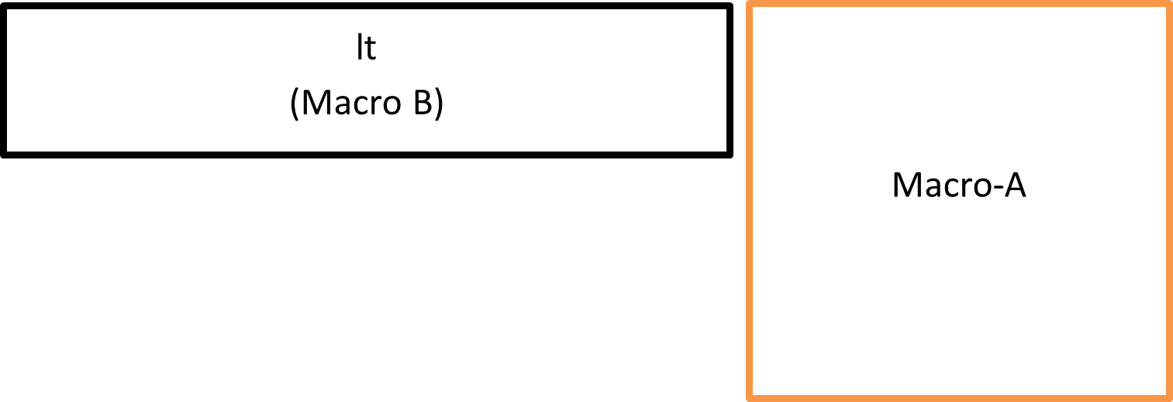
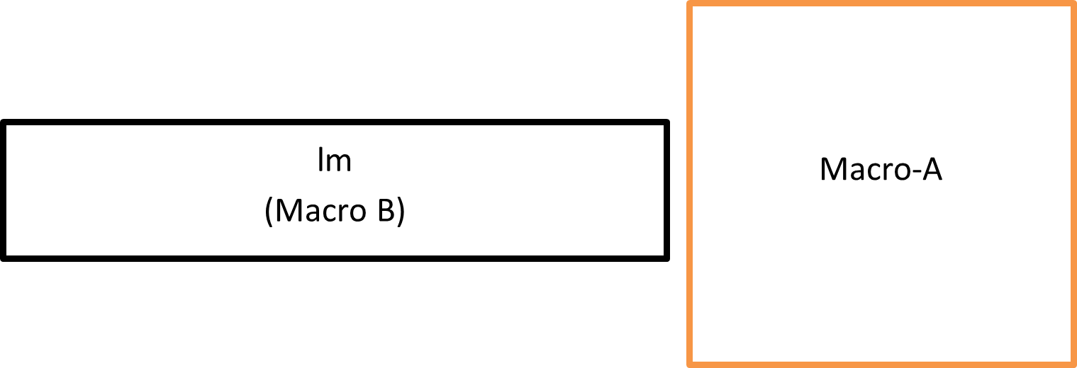
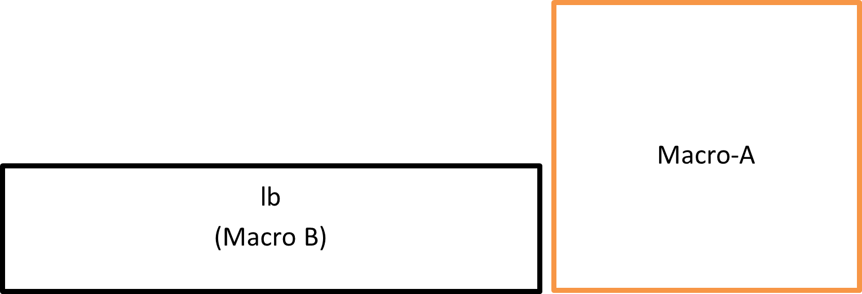
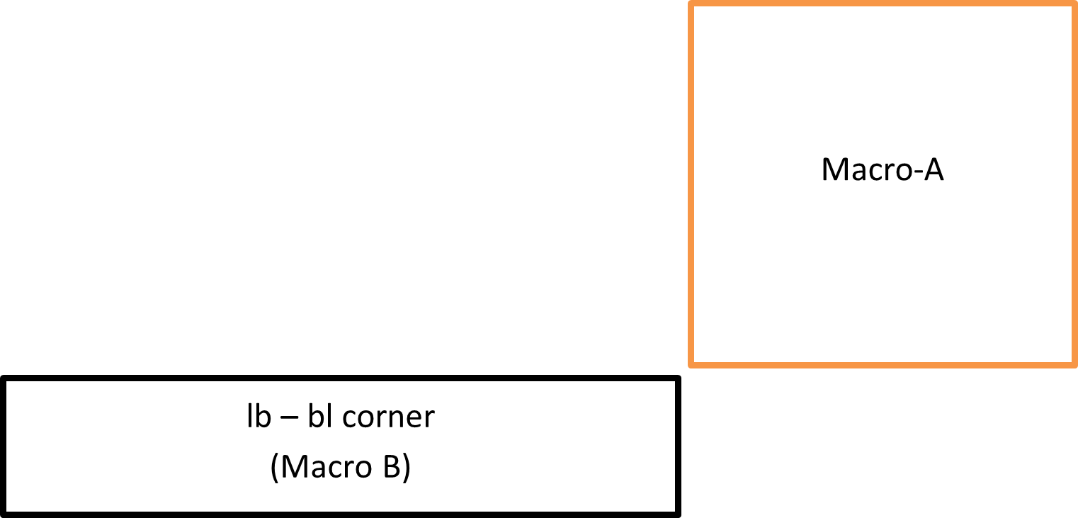
Left Top
Left Middle
Methodology
Left Bottom
Left-bottom or Bottom-left corner

Slide 12
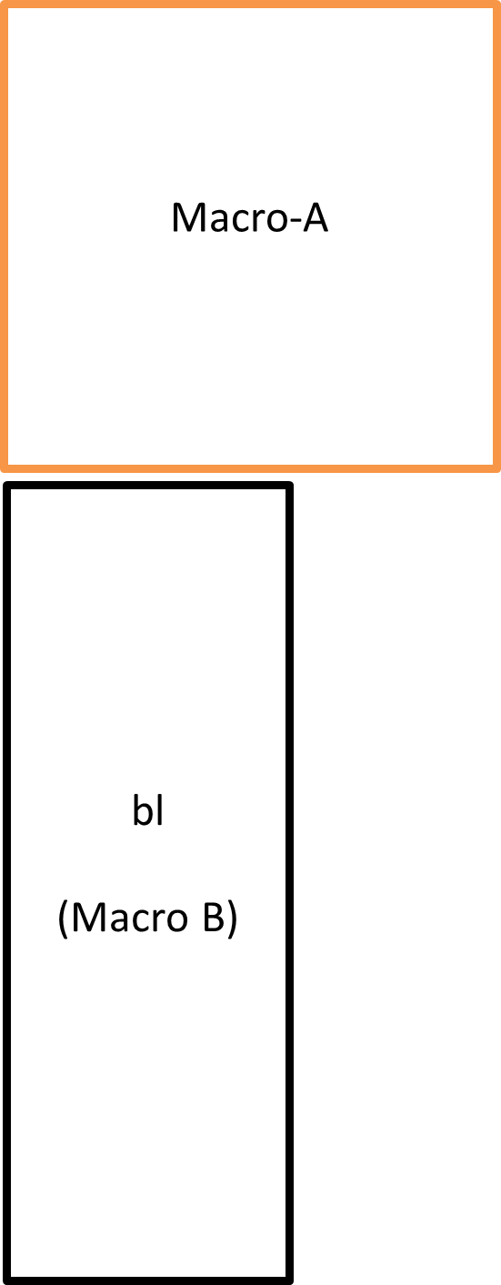
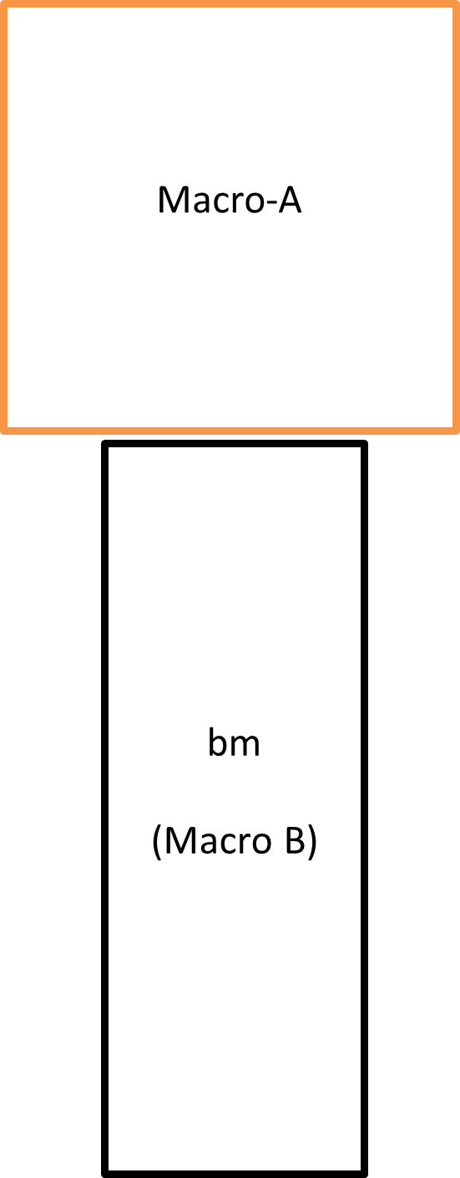
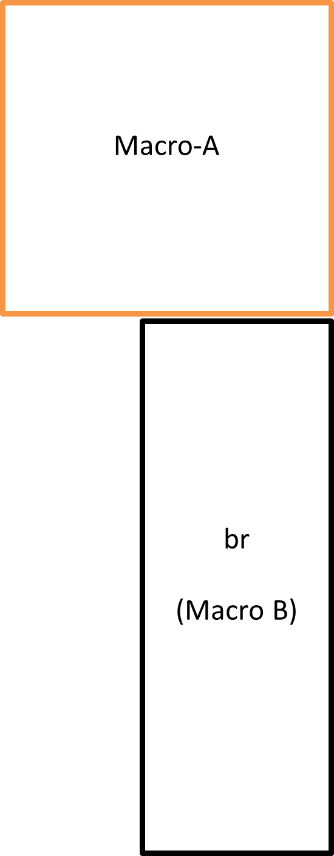
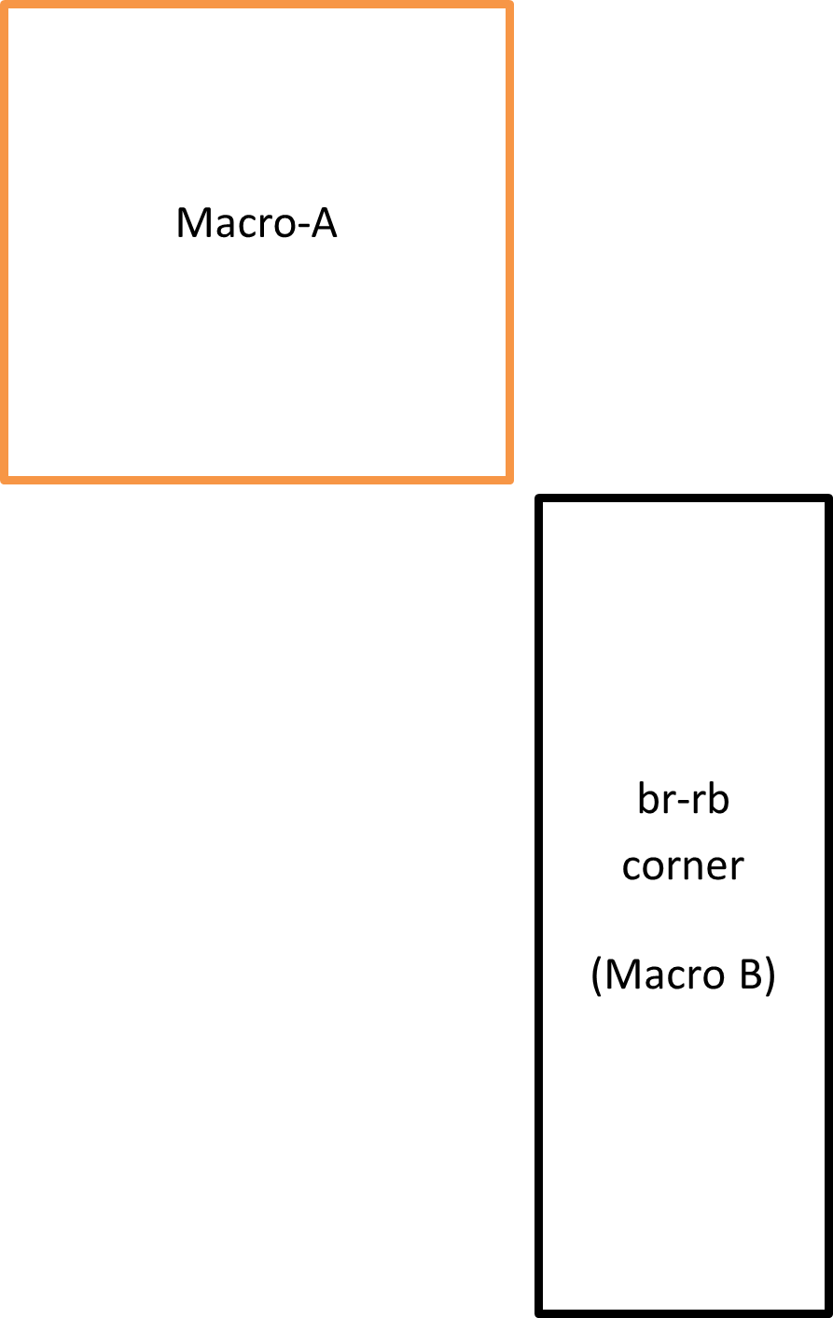
Methodology
Bottom-right or Right-Bottom corner
Bottom Left
Bottom Middle
Bottom Right

Slide 13
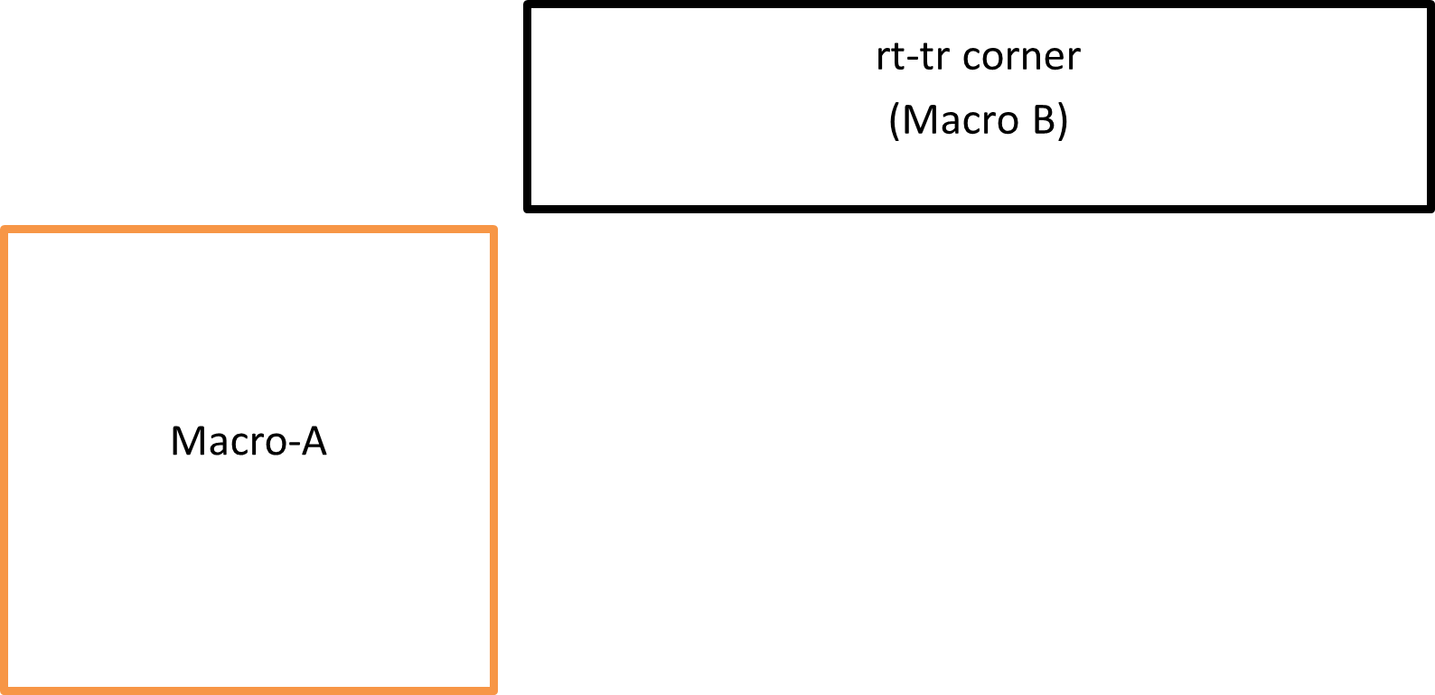
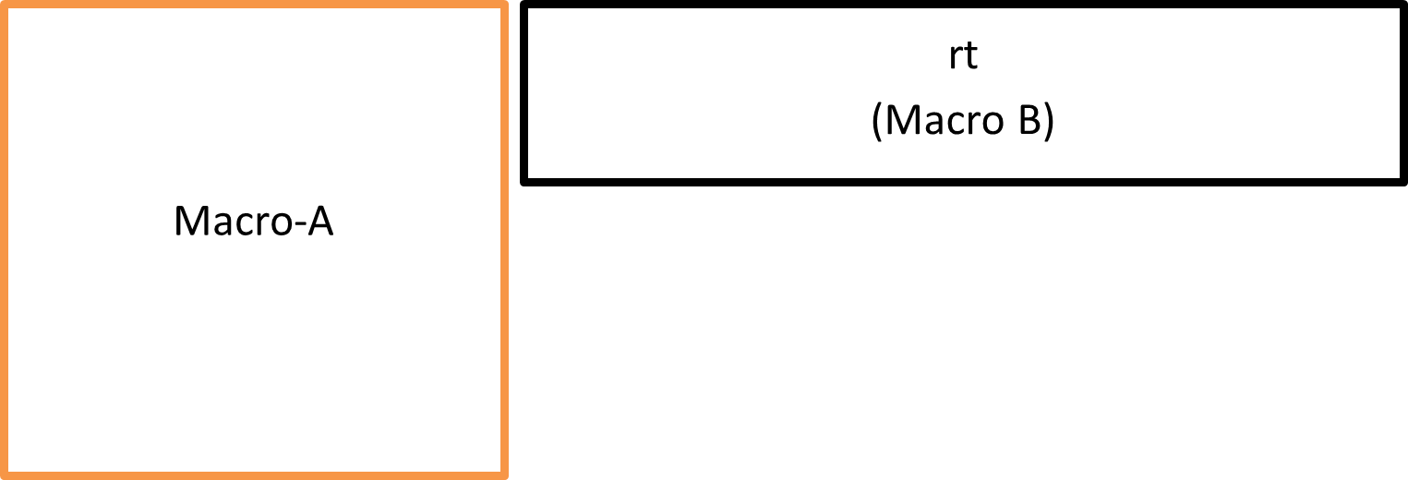
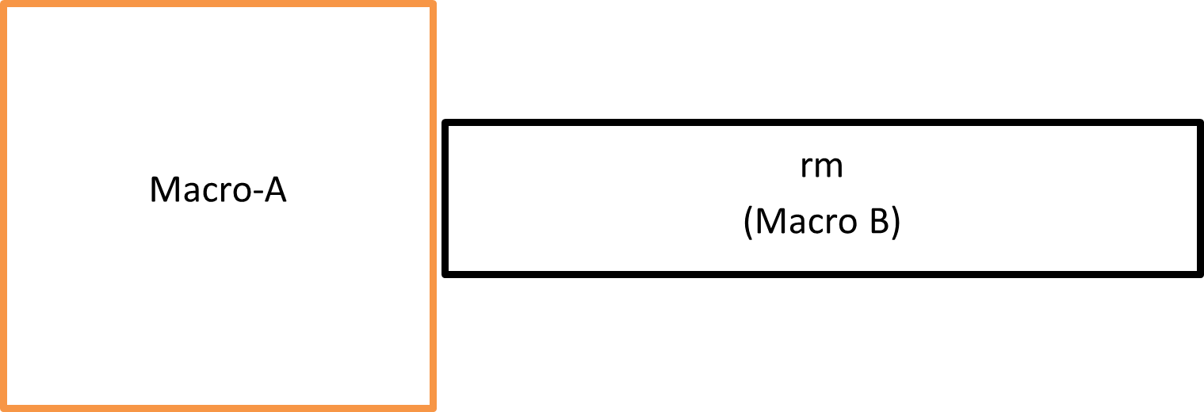
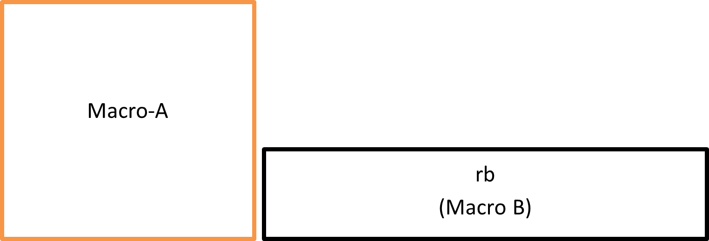
Right top or Top Right corner
Right Top
Methodology
Right Middle
Right Bottom

Slide 14
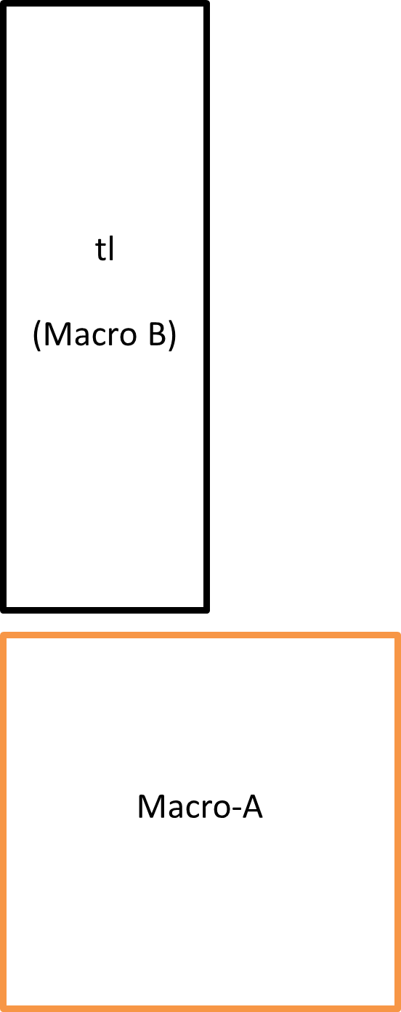
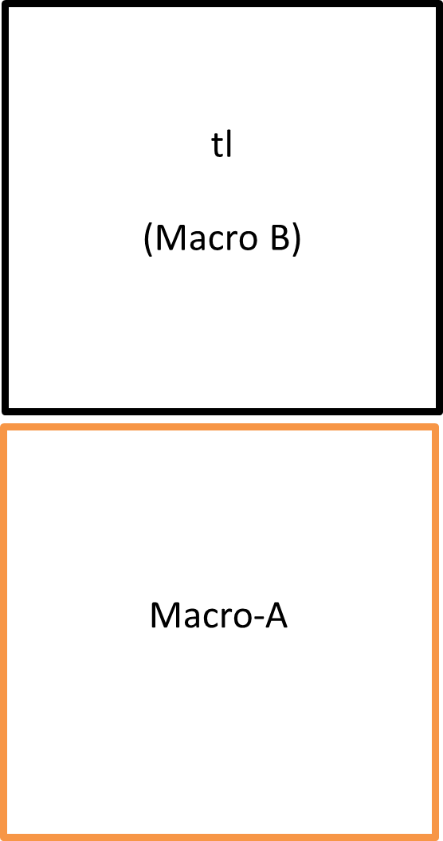
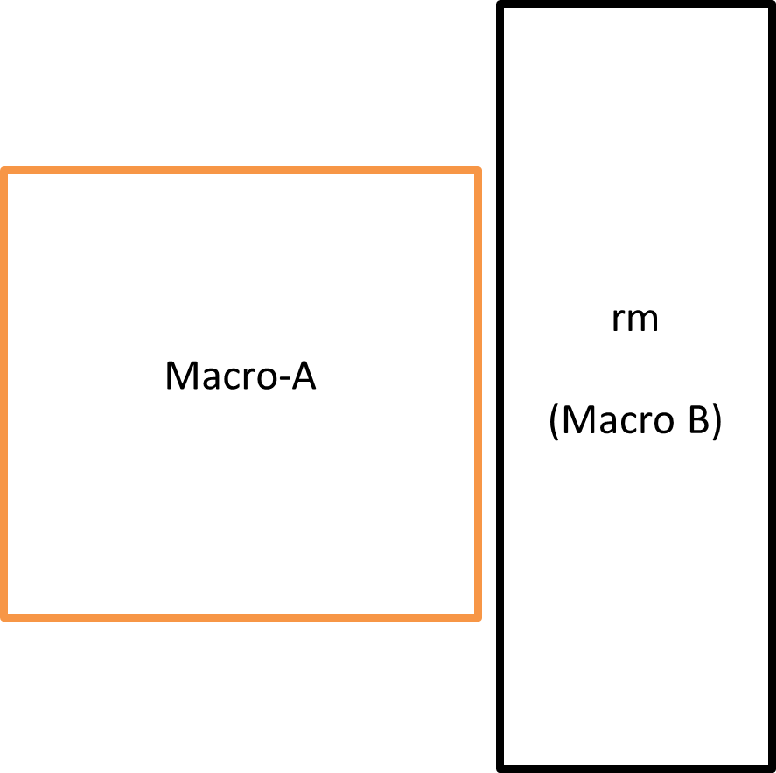
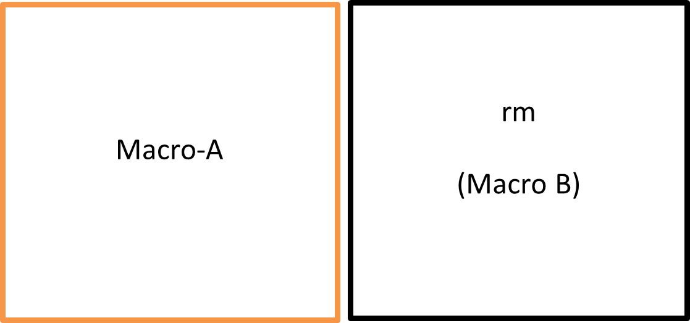
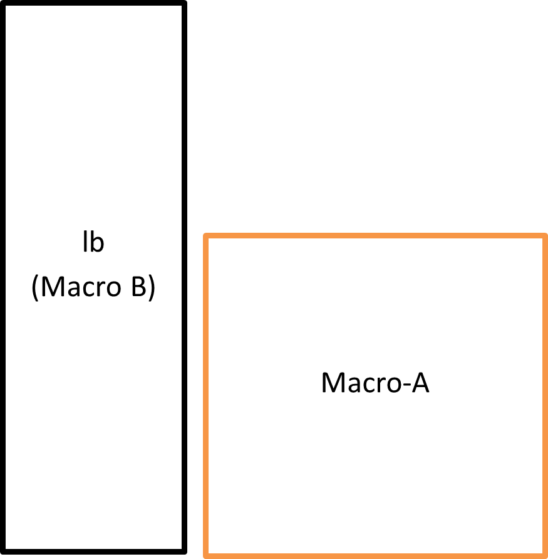
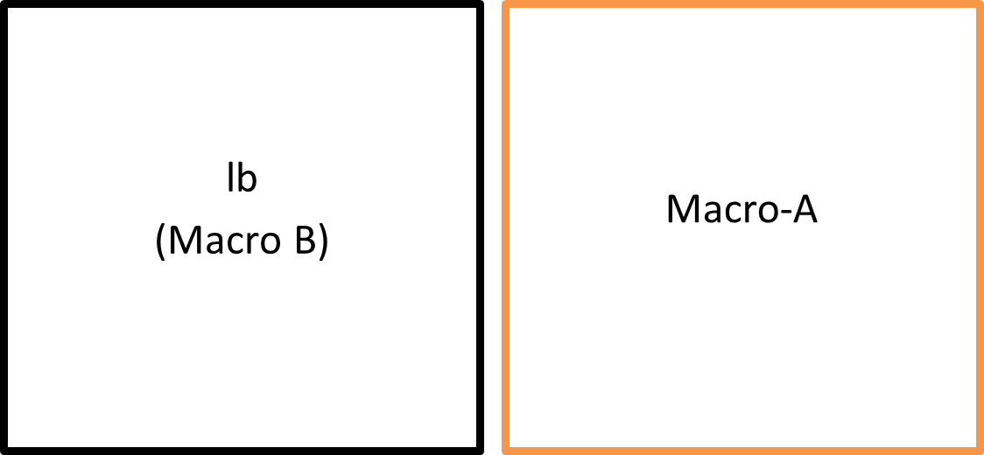
Methodology
Relative Macro Placement
Applicable irrespective of macro sizes.
Macro B can be wider or taller or same size as Macro A.

Slide 15
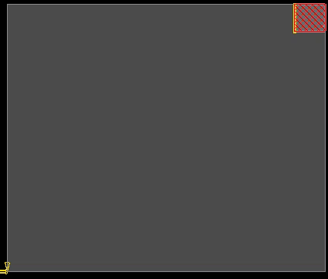
Methodology
Demonstration of placement carried out using place_mem command that is based on the relative placement methodology.
Initial placement w.r.t. core
Subsequent placements w.r.t. to already placed macros that builds upon existing placement analogous to building a puzzle.
Gap between macros when placing.

Slide 16
Methodology
Relative Placement
Absolute Placement
w.r.t. core:
place_mem "tr" "my" wt16k 2 3 0 0 C
“tr” => Relative alignment keyword
“my” => Instance orientation
“wt16k 2 3 0 0” => Instance name abbrev.
“C” => Argument symbolizing placement w.r.t. core
w.r.t. another macro
place_mem "bl" "my" wt16k 2 3 0 1 S wt16k 2 3 0 0 0 "d2c" "br“
“bl” => Relative alignment keyword
“my” => Instance orientation
“wt16k 2 3 0 1” => Instance name abbrev.
“S” => Argument symbolizing standard placement w.r.t another macro
“wt16k 2 3 0 0” => Relative instance abbrev.
0 => Distance between macros
“d2c” => Preciseness of placement.
“br” => Grid alignment keyword.
place_inst $inst "$X $Y" $inst_orient –fixed
“$inst” => Instance name to be placed
$X => X coordinate of the instance to be placed
$Y => Y coordinate of the instance to be placed
$inst_orient => Orientation of the instance
-fixed/-placed/-soft_placed => Placement Tag
place_mem runs place_inst under the hood right now but this can be developed further. Each macro can be thought of as an object which stores its neighboring macros.

Slide 17
Our Methodology
Advantages
(x₃ = w,
y₃ = h)
(x₁, y₁)
(x₁= 0,
y₁ = h
(x, y)
(x₂, y₂)
(x, y)
(x₂ = w,
y₂ = 0)
Absolute placement:
Requires multiple recalculation for each macro placed.
Time consuming and tedious process
Relative placement:
Requires initial calculation for the first macro placed. Coordinates for rest of the macros are known as height and width of the macro is known
Allows grouping of macros which is less compute intensive.

Slide 18
Our Methodology
Advantages
(x₃ = w,
y₃ = h)
(x₁, y₁)
(x₁= 0,
y₁ = h
(x, y)
(x₂, y₂)
(x, y)
(x₂ = w,
y₂ = 0)
Absolute placement:
Requires multiple recalculation for each macro placed.
Time consuming and tedious process
Relative placement:
Requires initial calculation for the first macro placed. Coordinates for rest of the macros are known as height and width of the macro is known
Allows grouping of macros which is less compute intensive.

Slide 19
Experimental Results
The script developed based on the Relative Placement methodology improved the turn-around time for the task of placement from around two weeks for a subset of the design i.e. Performance Functional Unit (PFU) to 3-4 days for the complete CNN sub-processor placement provided by our industry partner [4].
Optimized placement for the design space exploration was achieved in a span of two months.

Slide 20
Experimental Results
Placement build date | WNS(ns) | TNS(ns) | Wirelength (µm) | Utilization (µm) | Area (µm²)
Jan 28 | -0.01 | -0.82 | 40495153 | 5.29 | 17119490
Mar 07 | -0.03 | -2.91 | 38248240 | 21.73 | 19172197
Mar 22 | 0.00 | -0.02 | 23138843 | 23.3 | 13320277
Mar 29 | -0.08 | -32.85 | 25093516 | 42.61 | 13343707
Mar 30 | -0.03 | -4.52 | 25021953 | 42.24 | 13336693
Apr 12 | -0.04 | -3.87 | 24719999 | 25.34 | 13321562
Apr 24 | 0.00 | 0.00 | 23528766 | 30.47 | 12799161
Apr 29 | 0.00 | 0.00 | 21730693 | 44.68 | 12684283
Table II: Placement metrics obtained during the design space exploration of the CNN sub-processor

Slide 21
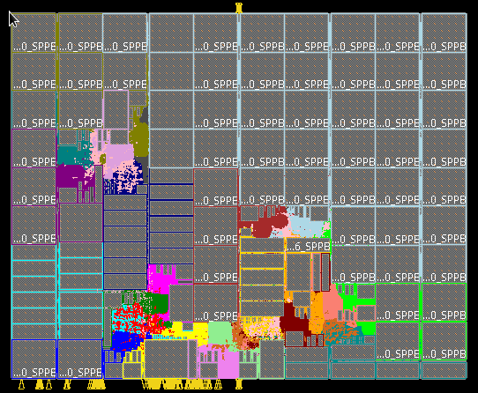
Experimental Results
Figure 4: CAD Tool achieved placement
Figure 5: DSE achieved placement

Slide 22
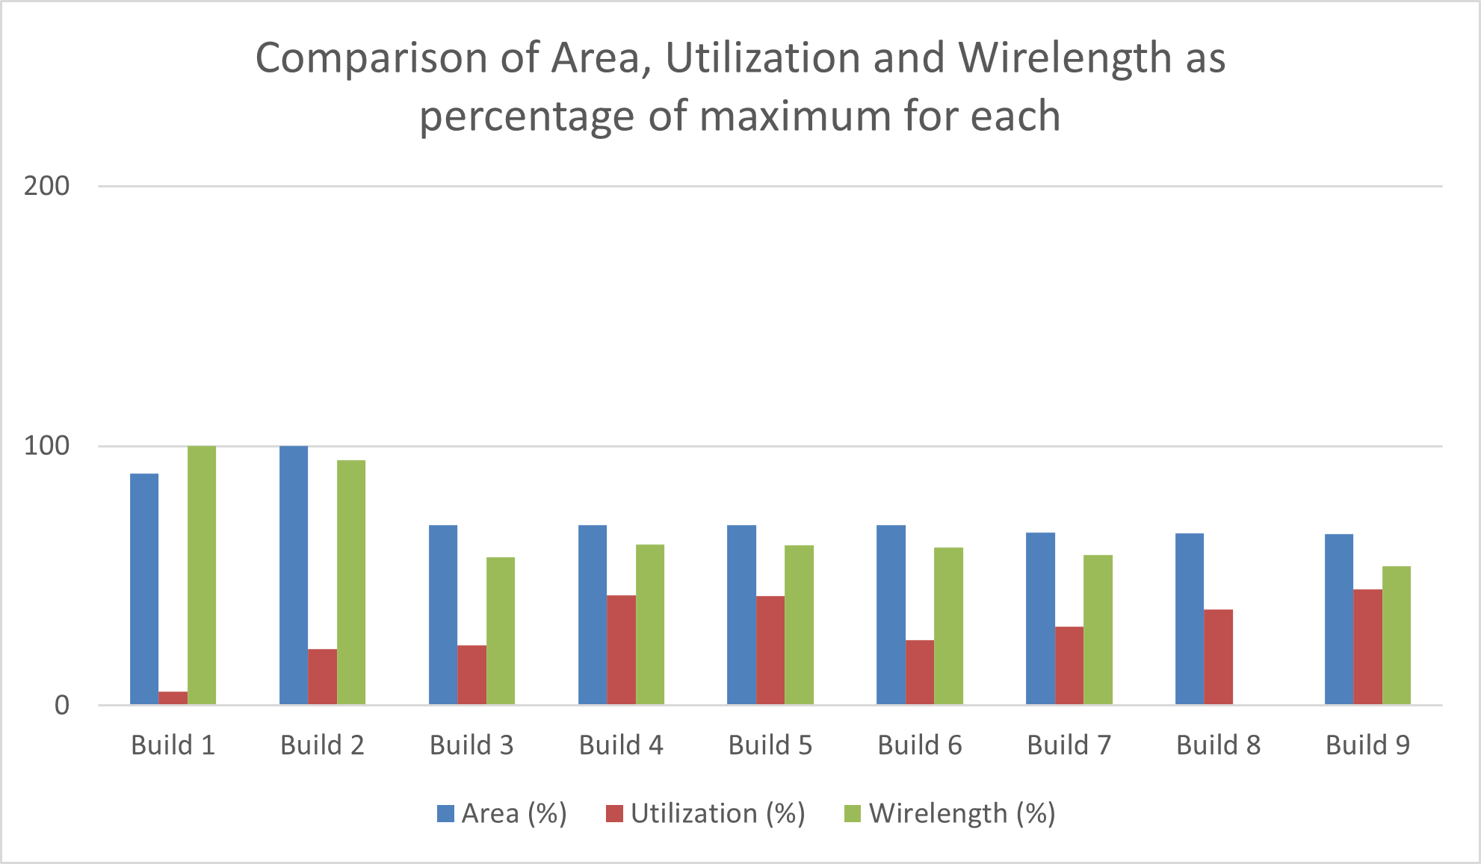
Experimental Results
Figure presents the comparison of Area, Utilization, and Wirelength as a percentage of the maximum value of each metric.
Figure shows that the area and wirelength kept decreasing steadily as iterative improvements were done in the memory macro placement (DEF).
Utilization shows a similar trend but with a peak at placements 4 and 5 because of a congested placement which led to better utilization but with poor timing.
Figure 6: Bar Graph comparing placement metrics as DSE progressed.

Slide 23
Conclusion & Future Work
Design space exploration led to a 25% area improvement which is a large saving in terms of cost. This DSE was made possible with the help of a relative placement methodology.
This methodology eased the process of macro placement and made placement iterations faster.
As a future task, the proposed relative placement script can be automatically generated by the tool based on GUI (Graphical User Interface) macro placements done by the user.
The relative placement command place_mem can be built into the tool instead of using the place_inst command that does absolute macro placements
Also, an RTL-Aware Dataflow-Driven Macro Placement tool that can achieve the physical placement of macros in an automated manner.

Slide 24
References
[1] Sarrafzadeh, M., Wang, M., Yang, X. (2003). Macro-Cell Placement. In: Modern Placement Techniques. Springer, Boston, MA. https://doi.org/10.1007/978-1-4757-3781-3_9
[2] I. L. Markov, J. Hu and M. -C. Kim, "Progress and Challenges in VLSI Placement Research," in Proceedings of the IEEE, vol. 103, no. 11, pp. 1985-2003, Nov. 2015, doi: 10.1109/JPROC.2015.2478963.
[3] Alex Vidal-Obiols, Jordi Cortadella, Jordi Petit, Marc Galceran-Oms, and Ferran Martorell. Rtl-aware dataflow-driven macro placement. In 2019 Design, Automation & Test in Europe Conference & Exhibition (DATE), pages 186– 191, 2019.
[4] Pavel SINHA. Configurable processor for implementing convolution neural networks. https://patentscope.wipo.int/search/en/detail.jsf?docId= WO2021014215, January 2021. Accessed: 2022-10-01.

Slide 25
Thank You!

